Slide 1
超越学科界限的认知基础 Transdisciplinary Cognitive Foundation
Story Telling about: arrows, analogy, metaphors, symmetry-breaking, and the essence of all stories Week 4
Ben Koo
October 5, 2020

Slide 2
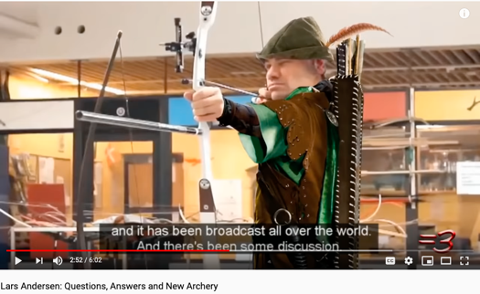

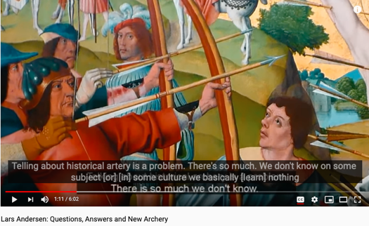
The Story of Moving Arrows (Archery)
A Personality (ies) (Lars Andersen)
The most amazing archer alive (think Robin Hood)
The Technology (Bows and Arrows)
The archer’s Paradox (science and wizardry)
Institutional/Societal Contexts
How does the society and institutional backdrop influence the practice of arrow shooting?
Notes:
Whats also refers to Data.

Slide 3
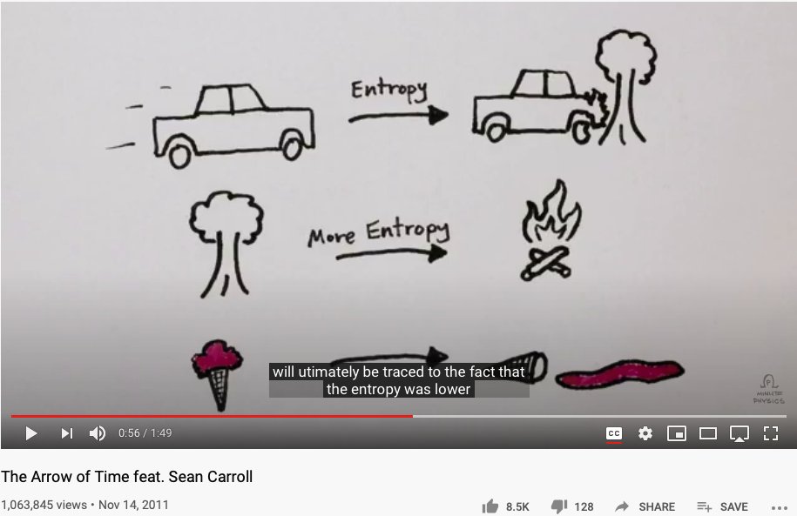
The Arrow of Time
Notes:
Whats also refers to Data.

Slide 4
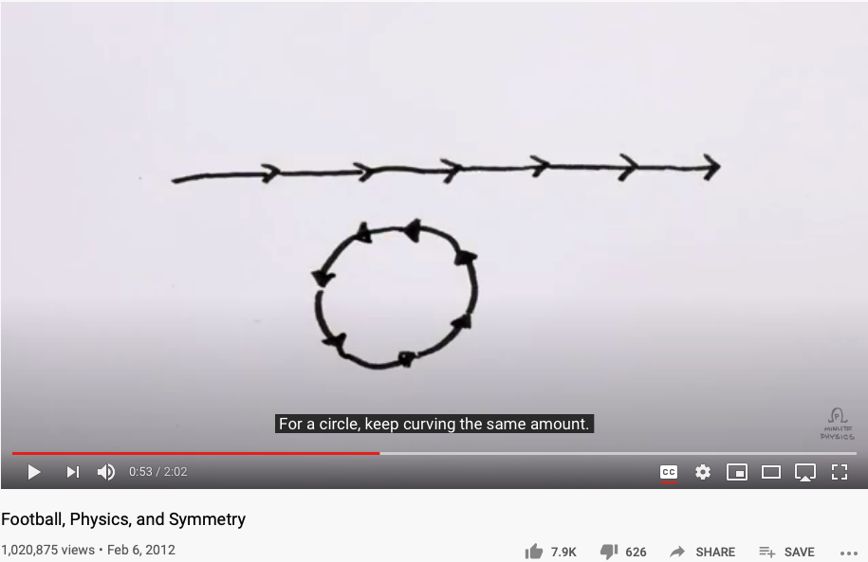
Arrows are about Symmetry-Breaking
Notes:
Whats also refers to Data.

Slide 5

Splitting the Arrow
Image Source: https://tvtropes.org/pmwiki/pmwiki.php/Main/SplittingTheArrow
Notes:
Whats also refers to Data.

Slide 6
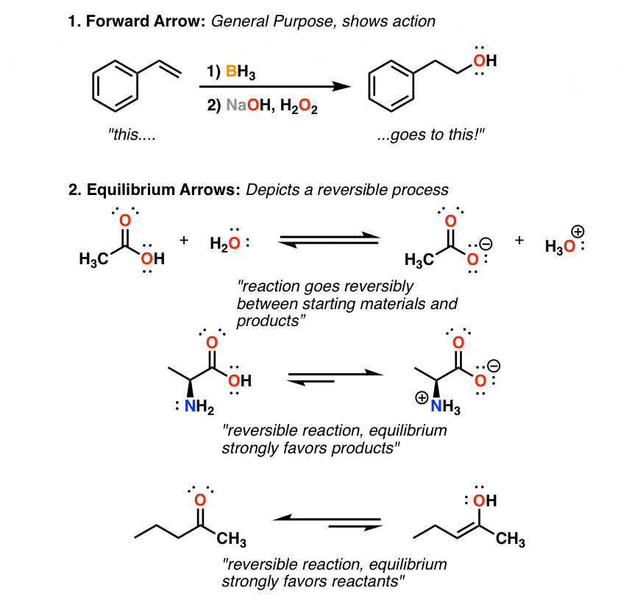
8 Types of Arrows in Organic Chemistry
Notes:
Whats also refers to Data.

Slide 7
Glossary
Terms related to Story Telling: analogies, metaphors, symmetry-breaking
Category Theory/范畴论: A foundation of all logic and mathematics
Morphisms(Functions/Functors/Natural Transformation): The only types of building blocks of Category Theory.
Analogies (metaphors): The fundamental building block of cognitive activities
Symmetry/Symmetry-Breaking, compression: The essence of analogies/morphisms.
Contextualization, Orientation, Measurement Units: The core elements in practical namespaces

Slide 8
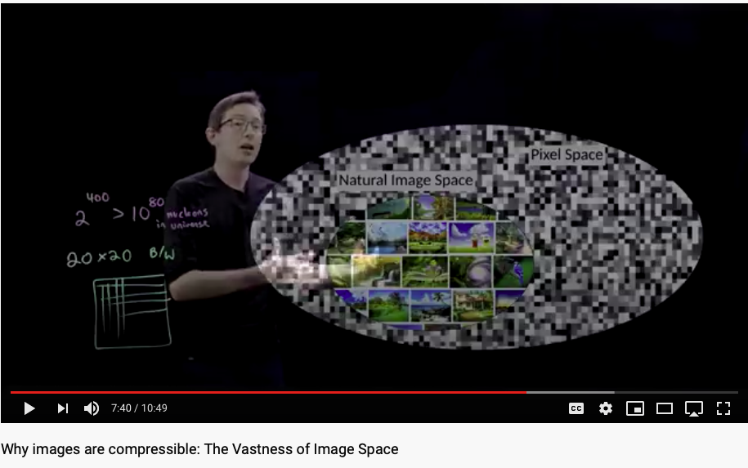
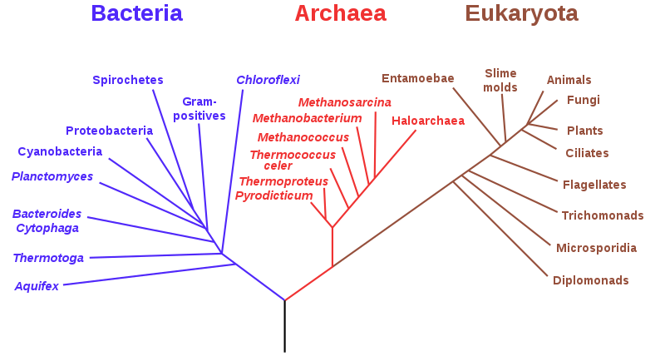
Can Monkeys tell a Shakespearean Story?
Think of natural images encoded in various trees just like DNA.

Slide 9
What is Transdisciplinary?
“transdisciplinarity represents the capable germ to promote an endogenous development of the evolutionary spirit of internal critical consciousness, where religion and science are complementary. Respect, solidarity and cooperation should be global standards for the entire human development with no boundaries. This requires a radical change in the ontological models of sustainable development, global education and world-society. We must rely on the recognition of a plurality of models, cultures and socio-economical diversification. As well as biodiversity is the way for the emergence of new species, cultural diversity represents the creative potential of world-society.”
Transdisciplinary Education as Ethic of the Diversity Reform in the World-Society of the 21st Century, article published by Javier Collado on June 20th: World Refugee Day in Global Education Magazine, ISSN 2255-033X

Slide 10

Why Transdisciplinary?
A foundation for reasoning
A unifying cognitive foundation cannot be separated by domain expertise
What and Why must be unified
Story telling reveals why through whats
The “whats” contextualize causation
Story telling, or a narrative, explains why
Any chosen narrative, embodies the causation through out its story composition, which links all the whats as collateral evidence to signify why.
Notes:
Whats also refers to Data.

Slide 11



Metaphors and Story Telling

Slide 12


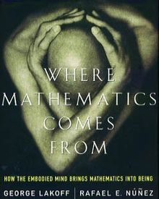
Metaphors as a Cognitive Foundation

Slide 13

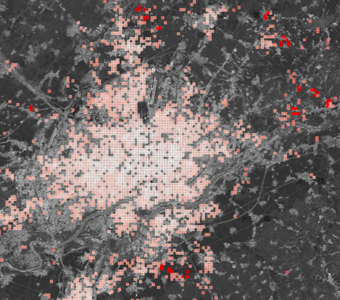
A Metaphor in Space http://ghostcities.mit.edu/
Prof. Sarah Williams of MIT Urban Planning Department

Slide 14
A Metaphor in Networked Documents
See Lo and Behold, the interview with Ted Nelson, Creator of Xanadu

Slide 15

Story Telling in a Workflow
Character Placement
Contextualization and Story Boarding
Order, Proportion and Proportionality
Promotion
Delivery

Slide 16
Contextualization and Story Boarding
Present a spacetime location
Present a spacetime location of event occurence
Story Boarding: (Event occurrence)
Make sure the storyline follows a consistent temporal logic
Closing the loop
Make sure that the story board resonate with the main thesis of the intentional message.

Slide 17
Character Design
Character Placement
Identify complementary roles to accentuate the unique nature of each part
Proper selection of roles may achieve best information compression.
Think about eigen values and eigen matrices
Assign right names to parts (通过命名加强人物角色设定）
Only involve relevant characters, and pick names that implicate their purposes in the plot

Slide 18
The “right” part out of a gazillion parts?
Can we leverage the historical data exemplified by the natural/biological wisdom on earth?

Slide 19
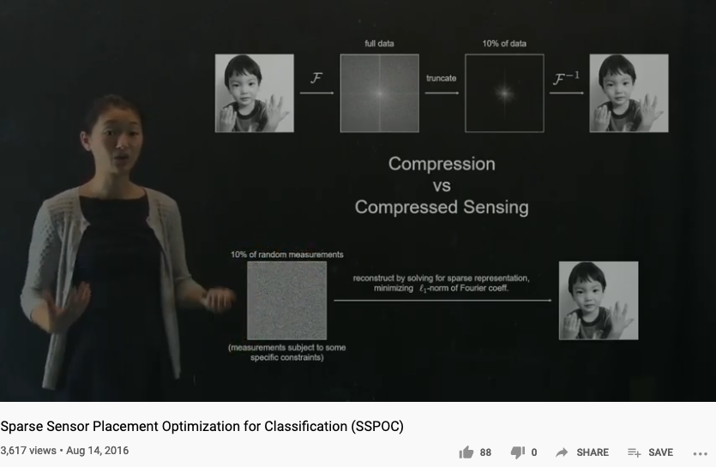
Compression Algorithms can help

Slide 20

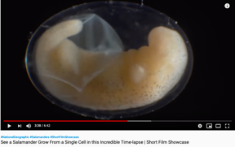
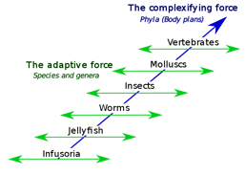
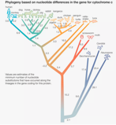
The Four Central Questions
Where to find natural/biological wisdom?
Causation | Ontogeny
Adaptation | Phylogeny

Slide 22
Ontogeny and Phylogeny as Strategies for NsM?
Ontogeny is the developmental history of an organism within its own lifetime, as distinct from Phylogeny, which studies the evolution of a species.
Phylogeny is the study of relationships among different groups of organisms and their evolutionary development.
Phylogeny and taxonomy are two systems for classifying organisms in systematic biology. While the goal of phylogeny is to reconstruct the evolutionary tree of life, taxonomy uses a hierarchical format to classify, name, and identify organisms.

Slide 23
Order, Proportion and Proportionality
Orders in time, in scale, and in proportions
Construct stories in abstract structures, such as Partially Ordered Sets (POS)
Organize story content in terms of temporal order, complexity scale, and relative proportions
Proportions between strategic elements in the story
Allocate the amount of resources to the story plot development in “balanced” proportions
Proportionality
Choosing a set of measurment units. (Natural Units, Metric/English Units, Computing Units)

Slide 24
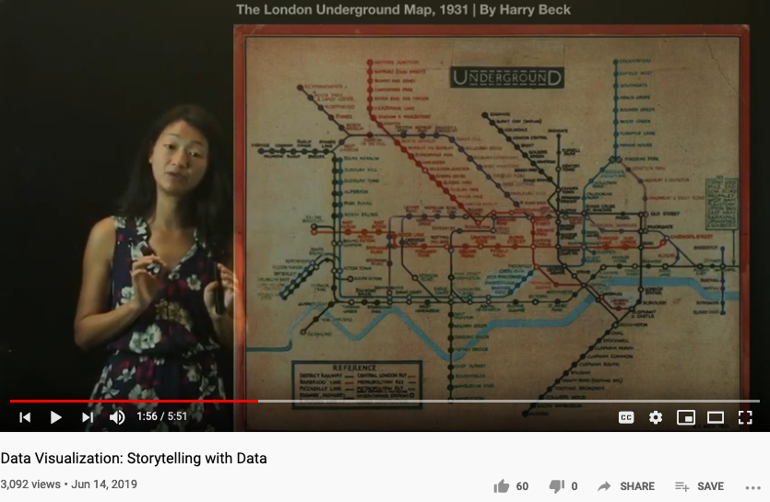
Order in time, sequences, locations

Slide 25
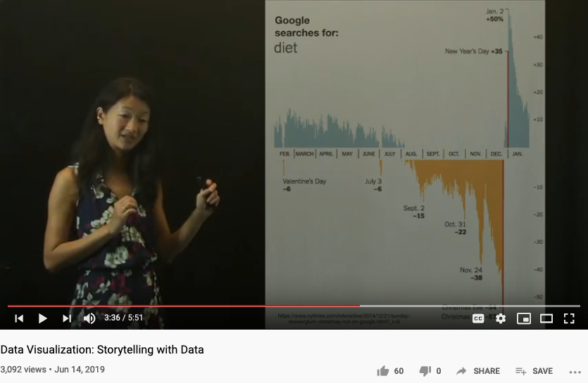
Proportion between key elements

Slide 26
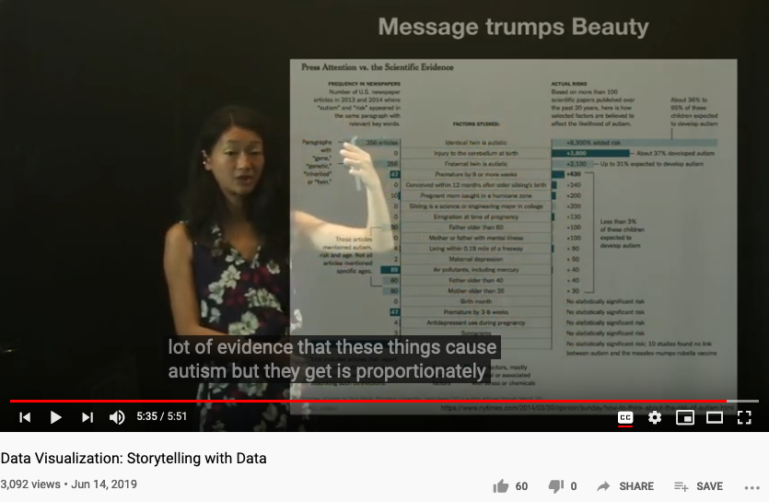
Measures and Proportionality

Slide 27
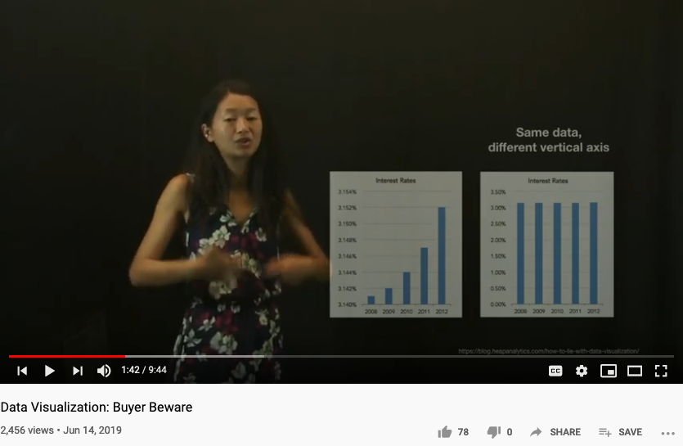
Buyers be aware!

Slide 28
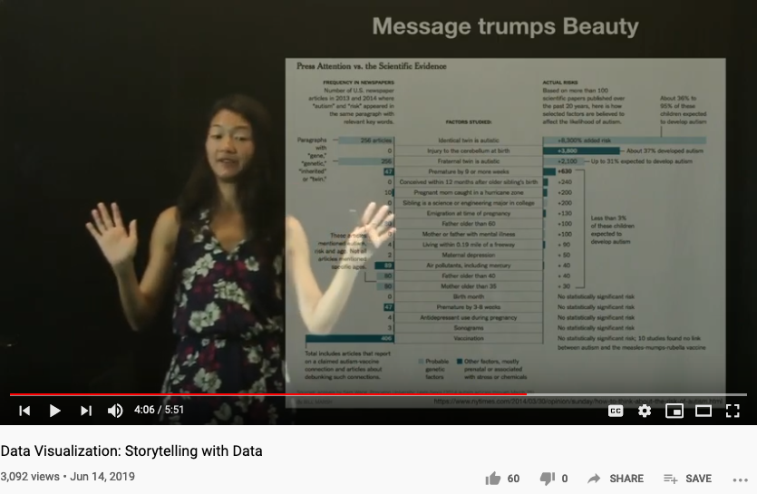
Message Trumps Beauty!

Slide 29
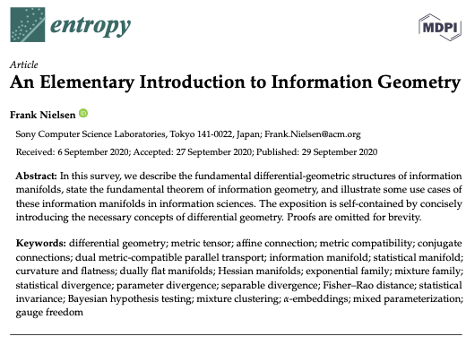
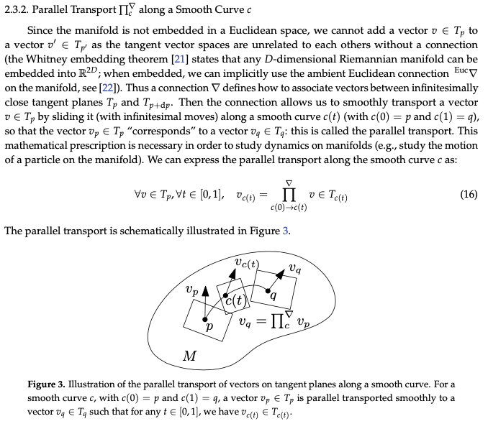
The Geometry of Information

Slide 30
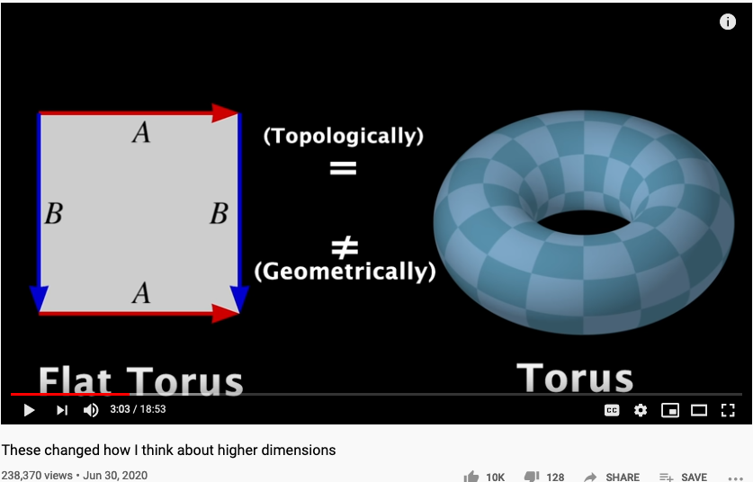
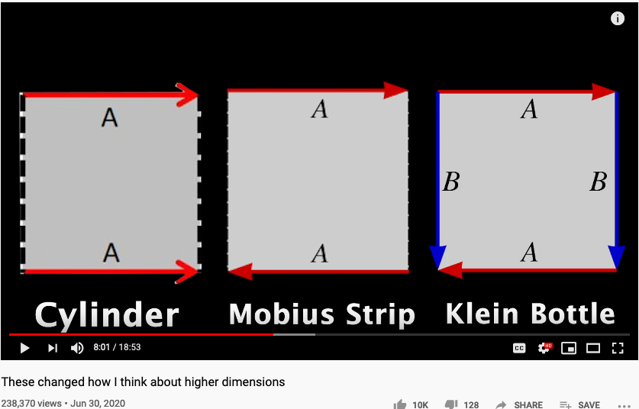
Higher Dimensional Structure denoted by Arrows
https://youtu.be/lmcT2mP2bfE?t=183
https://youtu.be/lmcT2mP2bfE?t=481

Slide 31
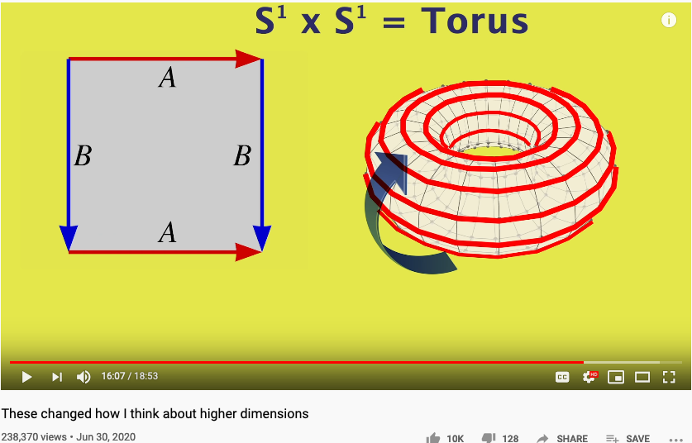
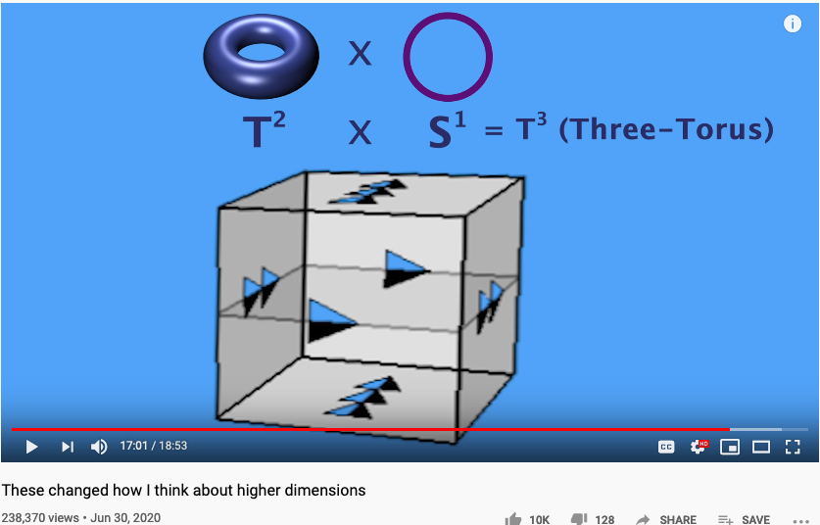
The Idea of Multiplication expressed in Arrows
https://youtu.be/lmcT2mP2bfE?t=967
https://youtu.be/lmcT2mP2bfE?t=1021

Slide 32
The World According to Category Theory
Find an image that shows arrow that
points to another arrow
A mathematical foundation based on one notation: arrow!
Also known as the arrow chasing computation.

Slide 33
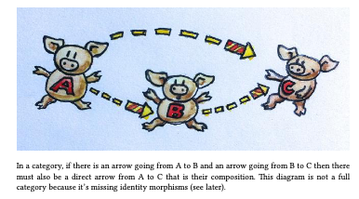
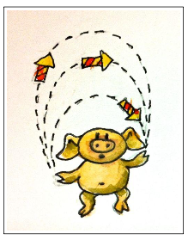
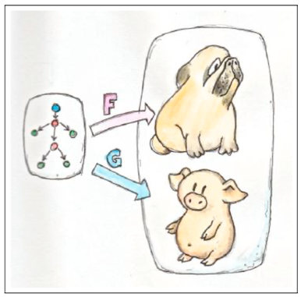
The Types of Arrows
If it looks like a pig, walks like a pig, and taste like a pig, it is a pig.

Slide 34
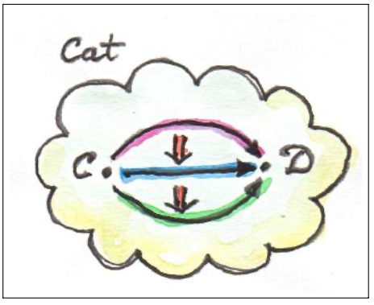
Verticle Composition
Page. 175 of Category Theory for Programmers

Slide 35
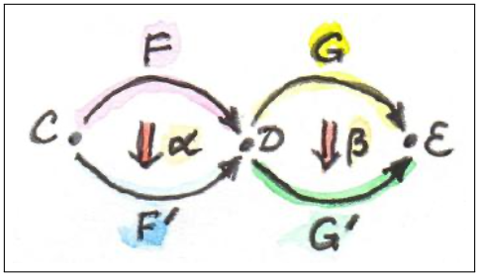
Horizontal Composition
Page. 176 of Category Theory for Programmers

Slide 36
Kleisli Arrow
The Fish Operator:
> = >
Page. 301 of Category Theory for Programmers

Slide 37
Category Theory and Unary Arithmetic
How to do computation with only one symbol?

Slide 38



















Three Kinds of Arrows
安全素养来自可分析、可聚合的思维基础，三层次的认知和范畴论中的类比与函数具有对应关系
1.函数 (Function)
$$A \underset{→}{ f } B$$
$$A$$
Object / Set $A$
Category $S$
A function $f$ from set $A$ to set $B$
2.函子 (Functor)
$$S$$
$$\underset{→}{ F }$$
$$T$$
$$A \underset{→}{ f } B$$
$$C \underset{→}{ g } D$$
A functor $F$ from category $S$ to category $T$
$$S \underset{→}{ F } T$$
Functor $F$
$$F$$
3.自然转换 (Natural Transformation)
Natural transformation compares a parallel pair
$$S$$
$$T$$
$$F \underset{→}{ η } G$$
$$η$$
Natural Transformation $η$
$$G$$

Slide 39
The Idea of Universality
范畴论：用箭头当作对所有信息编码的唯一一类符号

Slide 40
Construct Story Telling using Metaphorical Connections
 | Story Telling | Metaphors | Categorical Arrows
Dynamics | Story Plot | Types of Outlines | Natural Transformation
Compositional Laws | Morals of the Story | Existing Stories | Functor/Structure Preservation
Building Blocks (BB) | Spacetime Context and the Characters | Names of the BB | Functions/Morphisms/Objects

Slide 41





Category Theory
Viable airspace
trajectories
Blockchain
Is the tool to represent and compute complex networks
Cognitive and Brain Science
A.I. decision Matrix
Start-Up viability
Predict formerly unpredictable
Solve the Mysteries of Life
Notes:
Predict formerly unpredictable

Slide 42

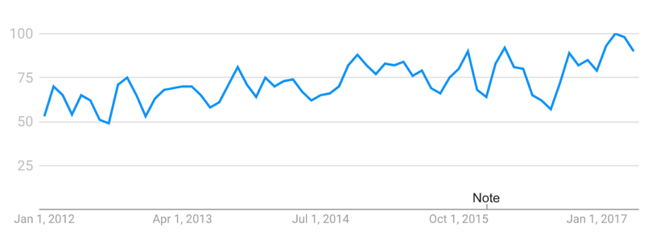
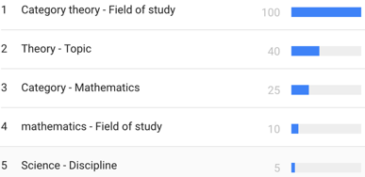
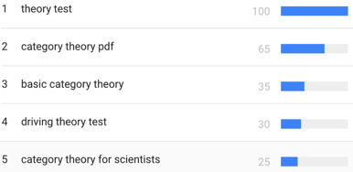
Trend
Based on
“category theory” interest over past 5 years (worldwide):
Legend:
Numbers represent search interest relative to the highest point on the chart for the given region and time.
A value of 100 is the peak popularity for the term.
A value of 50 means that the term is half as popular.
Likewise a score of 0 means the term was less than 1% as popular as the peak.
Related topics
Related queries
Legend
The most popular topics. Scoring is on a relative scale where a value of 100 is the most commonly searched topic, a value of 50 is a topic searched half as often, a value of 0 is a topic searched for less than 1% as often as the most popular topic.
Legend
The most popular topics. Scoring is on a relative scale where a value of 100 is the most commonly searched topic, a value of 50 is a topic searched half as often, a value of 0 is a topic searched for less than 1% as often as the most popular topic.
Notes:
Category theory has become an important role in contemporary mathematics and theoretical computer science.

Slide 43
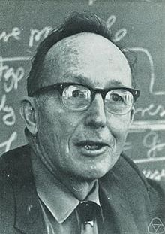
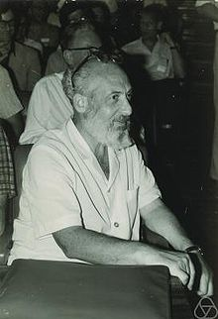
Founders of Category Theory:
Saunders Mac Lane/Samuel Eilenburg
https://en.wikipedia.org/wiki/Saunders_Mac_Lane
https://en.wikipedia.org/wiki/Samuel_Eilenberg
Notes:
Category theory has become an important role in contemporary mathematics and theoretical computer science.

Slide 44
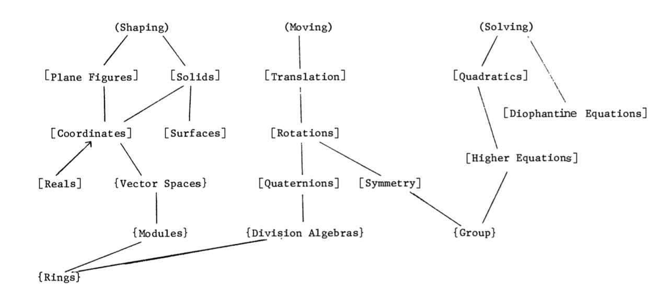
Mathematical Models:
A Sketch for the Philosophy of Math (1981)
The Lower part of the Table 1 of the paper
http://links.jstor.org/sici?sici=0002-9890%28198108%2F09%2988%3A7%3C462%3AMMASFT%3E2.0.CO%3B2-D
Notes:
Category theory has become an important role in contemporary mathematics and theoretical computer science.

Slide 45
Mathematical Models:
A Sketch for the Philosophy of Math (1981)
Mathematics begins with puzzles and problems dealing with combinatoric and symbolic aspects of the general human experience. Some of these aspects turn out to be systematic and intrinsic, rather than arbitrary and tied to one context. … These observations can be described as starting with a variety of human activities, each one of which leads more or less directly to a corresponding portion of mathematics:
Counting | Arithmetic, Number Theory
Measuring | Real Numbers, Calculus, Analysis
Shaping | Geometry, Topology
Forming | Symmetry, Group Theory
Estimating | Probability, Measure Theory
Moving | Mechanics, Calculus, Dynamics
Calculating | Algebra, Numerical Analysis
Proving | Logic
Puzzling | Combinatorics, Numer Theory
Grouping | Set Theory, Combinatorics
http://links.jstor.org/sici?sici=0002-9890%28198108%2F09%2988%3A7%3C462%3AMMASFT%3E2.0.CO%3B2-D
Notes:
Category theory has become an important role in contemporary mathematics and theoretical computer science.

Slide 46
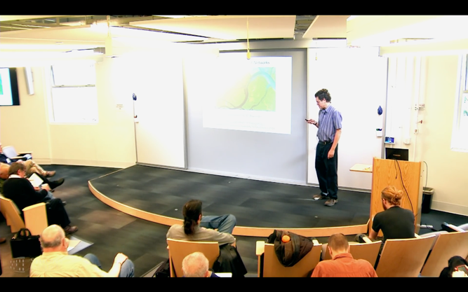
范畴论就是： 复杂网络的数学
John Baez* : “Category Theory is the Mathematics of networks.”
https://www.youtube.com/watch?v=IyJP_7ucwWo
Based on Marquis, Jean-Pierre on Stanford Encyclopedia of Philosophy**: “Category theory has become an important role in contemporary mathematics and theoretical computer science. It is a powerful language, or conceptual framework, allowing us to see the universal components of a family of structures of a given kind, and how structures of different kinds are interrelated”
Source: *John Baez’s Stuff, http://math.ucr.edu/home/baez/
**Jean-Pierre Marquis, https://plato.stanford.edu/archives/win2015/entries/categorytheory/
Notes:
Category theory has become an important role in contemporary mathematics and theoretical computer science.

Slide 47
范畴论: 不需要数字的计算方法（基于箭头的算术）
A Category is a diagram composed of Objects and Arrows
构成
B
f
g
h
A
C
案例: 由三个对象 (A,B,C) 和两个箭头(f, g)所构成的范畴
“Category Theory is a graph with a rule for composing arrows (f,g) head to tail to give another arrow (h)。”
M. Barr, and C. Wells, Category theory for computing science. 1990. 21.

Slide 48
Formal Definition of Category Theory
所有的范畴必须满足以下条件：
id_{B}
B
f
g
A
C
id_{A}
id_{C}
由箭头与箭头所指的对象所构成
每一个对象X 必然有一个自指的箭头 id_{X}
首尾相连接的箭头可以“构成”（compose）新的箭头

Slide 49
Category Theory is about composing Arrows
下列两个箭头( f, g ) 可被构成/聚合 (composed ) 为一个箭头 h
B
f
g
A
h
C
范畴论的符号系统是用来展现函数/函子/自然转换的可聚合性（composability）

Slide 50
Compute by Arrow Chasing
B
B
Always implies:
f and g can be
composed into
h
where
h = g ◦ f
f
g
f
g
A
h
C
h = g ◦ f
A
C
Functional Composition
h = g ◦ f

Slide 51
Measurement results come from:
comparison/symmetry-breaking

Slide 52
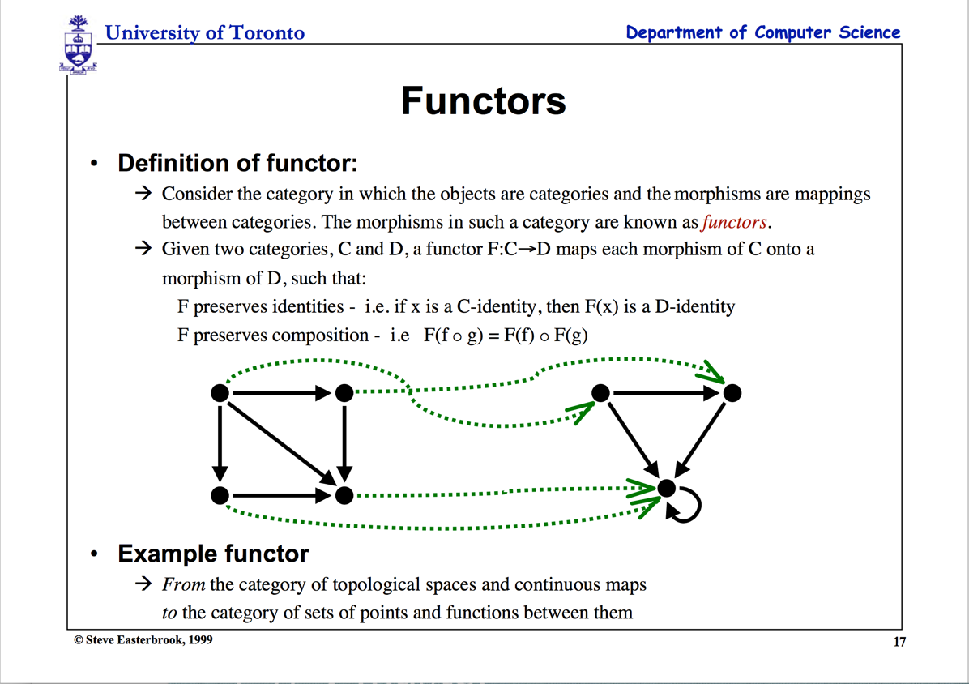

Slide 53
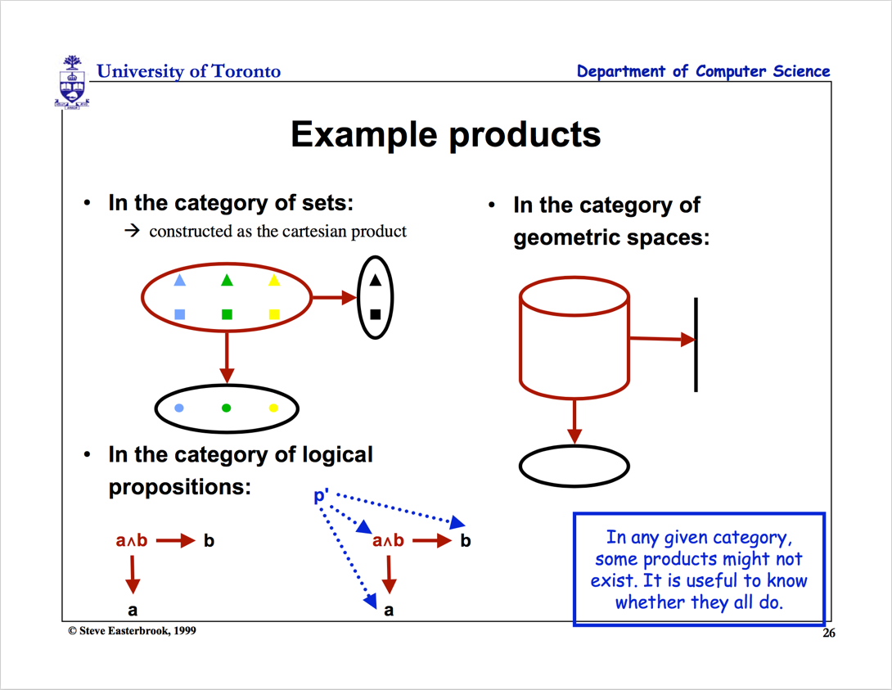
Multiplication

Slide 54
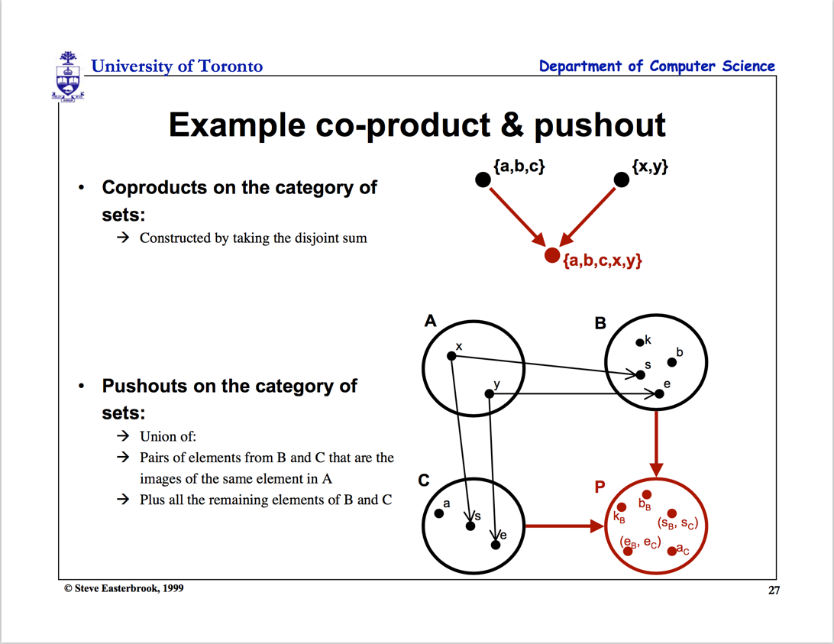
Addition

Slide 55


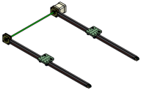
Functional Composition
Decomposition
C
C ^{OP}
3D printing
3D printing
g
F ^{op}
f
f ⁻¹
g ⁻¹
2D printing
1D movement
(Opposite Functor)
2D printing
1D movement

Slide 56

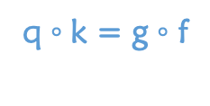







函数对等性与交换律(Commutativity)
两条首尾对象相同的路径表示:两套函数 (morphisms) 可对等交换 “commutes”
h = g ◦ f
$$\underset{→}{ f }$$
$$\underset{→}{ g }$$
The crucial aspect of a category is that
two appropriately compatible arrows can
be combined (by composition ) to form a third
arrow.
$$\underset{→}{ h }$$
$$\underset{→}{ f }$$
q ◦ k = g ◦ f
$$\underset{→}{ k }$$
$$\underset{→}{ g }$$
$$\underset{→}{ q }$$

Slide 57
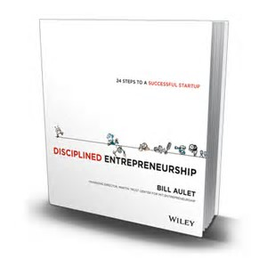
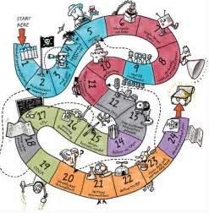
Any ordered system，can be represented by Arrows

Slide 58
Workflow or product systems in Arrowed Structures
Initial Idea
Identify Customer Needs
Establishing technical specification
Initial Idea
Collecting competitive benchmarking
Identify Opportunities
List of Customer Needs
List of Opportunities
Reflect on the result and the process
Evaluate and Prioritize Project
Establish the relative importance
Reflect on the result and the process
Filtered Opportunities
Filtered Customer Needs
Allocate Pre-project Planning
Interpret raw data in terms of customer need
Project Idea
Customer Needs Raw Data
Gathering Raw Data
Re-evaluate Result and Process

Slide 59
(Following from Previous page)
Target Specification
Concept Generation
Establishing technical specification
Final Product Concept
List of Metric Specifications
Measuring & interpreting concept
Reflect the result and the process
Collecting competitive benchmarking
List of Survey Result
Surveying concept
Competitive Evaluation List
List of Concept Scoring
Set Ideal marginal value
Scoring
Re-evaluate screening
Re-evaluate Result and Process
Target Specification List
List of Concept Screening
Screening
List of Concept Generation
Determining concept generation

Slide 60
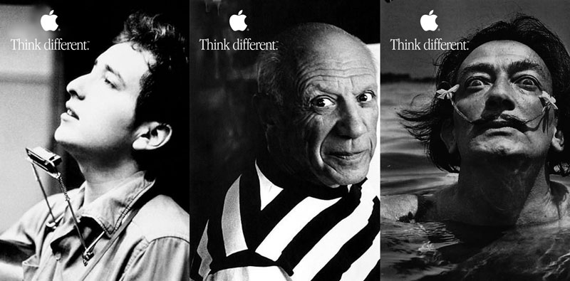
The Commonalities of these different characters?
Notes:
Nespresso borrowed the insights from Hp, basically “If selling replacements is succesful then we have to focus on the replacements to succeed”
Borrowing experiences across industries to overcome Industry Barriers and failing one and again with the same complex problems.

Slide 61



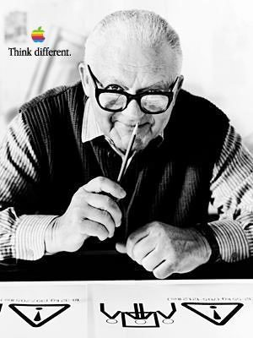



Product Design by “Analogy”
C
F (Functor)
g
h
Maps similar structures across categories
h·g
F (Functor)
D
Think different, yet the same!
Notes:
Nespresso borrowed the insights from Hp, basically “If selling replacements is succesful then we have to focus on the replacements to succeed”
Borrowing experiences across industries to overcome Industry Barriers and failing one and again with the same complex problems.

Slide 62






Would simple “analogy” always work?
Development Process
g
h
C’
F
h·g
F (Functor)
αG
C’’
Category Company C
F’ (Functor)
?
?
C’’’
Notes:
Nespresso borrowed the insights from Hp, basically “If selling replacements is succesful then we have to focus on the replacements to succeed”
Borrowing experiences across industries to overcome Industry Barriers and failing one and again with the same complex problems.

Slide 63


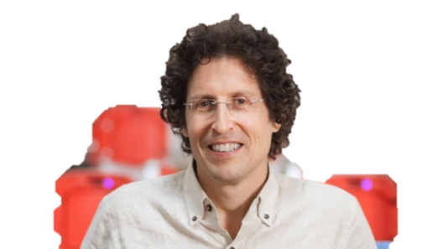
Juicero Case
What happened?
120M USD
Doug Evans
Notes:
Initial idea:
Innovative small press could change the juicing industry.
Identify Customer Needs:
Customers need juice or a press?
Customers need fast and clean juice making
Smart phone app to monitor their diet
Target Specification:
Thousands of pounds on 200 cm² surface press
Home appliance or Businesses?
Producing a juice in <90 s
Concept Generation:
Over engineered (24 pieces for the lock door system).
Cold pressured
QR scan to apply the exact pressure.
-----------------------------------------------------------------------------------------------

Slide 64





Juicero by borrowing “Analogies”
Company
Development Process
Promotion Channel
F
h
f
αG
Natural transformation
h
G
g
i
H
Notes:
Nespresso borrowed the insights from Hp, basically “If selling replacements is succesful then we have to focus on the replacements to succeed”
Borrowing experiences across industries to overcome Industry Barriers and failing one and again with the same complex problems.

Slide 65
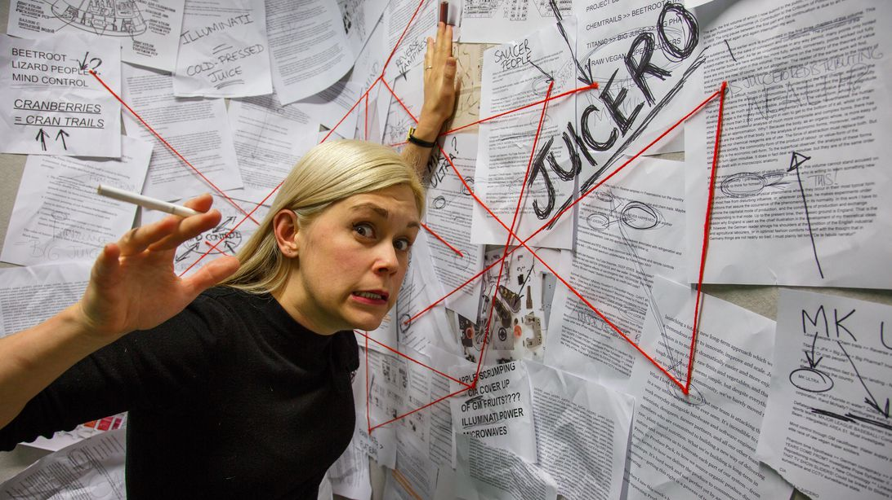

Juicero as a Textbook Case Study
Notes:
Nespresso borrowed the insights from Hp, basically “If selling replacements is succesful then we have to focus on the replacements to succeed”
Borrowing experiences across industries to overcome Industry Barriers and failing one and again with the same complex problems.

Slide 66
Conflicts/Branches/Intersections that don’t exist in Higher Dimensions

Slide 67
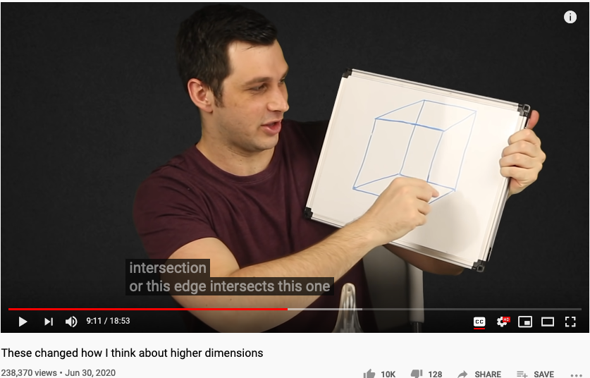
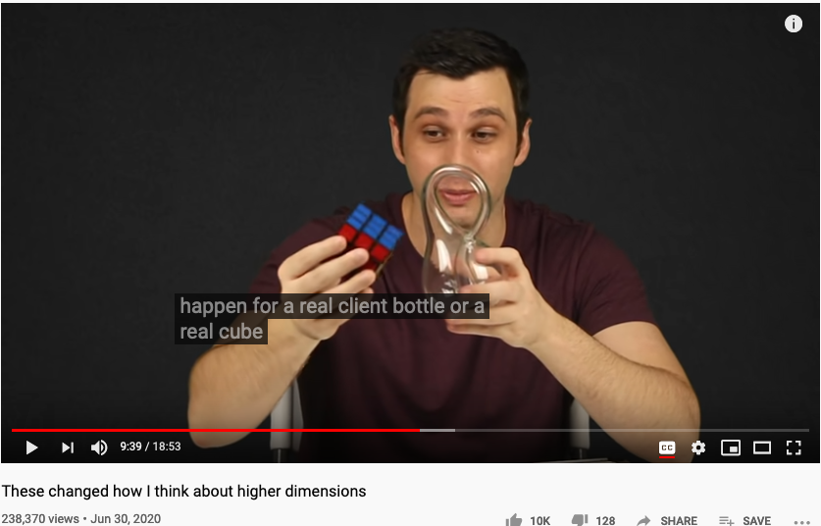
Counter Arguments in Higher Dimensions (intersection will not occur in Higher Dimensions)
https://youtu.be/lmcT2mP2bfE?t=551
https://youtu.be/lmcT2mP2bfE?t=579

Slide 68


范畴论可简化复杂的计算过程
Represents ONLY SOME possible trajectories to the moon
NKS 2004, MIT A New Kind of Language for Complex Engineering Systems
Case Study: NASA’s Apollo Program Benjamin Koo
Edward F. Crawley

Slide 69
完全没有算数逻辑的学科，不便成为科学！

Slide 70
外部因素：描述会 渗透/穿透 “运营背景” 边界的关键因素
抽象规范
运营背景：包括宏观/中观/微观时空场域的常用“标签”
目标：以在特定场域中达到欲求效果的 一个项目/函数/箭头 统一标签的别名
效果检验：为了达成目标的输出效果与输入资源的检验条件
输出结果：
可被统一的时间标签与命名空间联系的数据结果
具体实现过程
项目或函数的实现过程/算法细节
每一个实现过程与算法也可以被统一的标签来命名
输入资源：
可被统一的时间标签与命名空间联系的数据结果

Slide 71
Universality : 新旧合冶，殊途同归
学说 | 范畴论 | 物理学 | 柏拉图《理想国》 | 《理想国》中的洞喻 | 东方文化 | 计算思维
对象 | 对象 | 基本粒子 | 影像、理念 | 影子、木偶 | 感官（六触、十二处、十八界）、本性 | 输入、输出的比特和量子比特数据
关系 | 箭头 | 四种相互作用 | 投射，显现 | 火光映射 | 缘起 | 通用的逻辑门或Hamiltonian时间演化、拓扑结构变换
结构 | 映射结构 | 大统一理论(QM/SR/GR/GFT) | 以辩证法为主体的城邦护卫者的教育学 | 从洞内到地面的显现过程 | 中观（性空），唯识（缘起现象），心学（惟精惟一，允执厥中） | 逻辑门线路模式、绝热演化模式、拓扑变换模式
主客观之间 | 打通 | 接近打通：量子测量 | 留有空间：“假设” |  | 打通 | 人脑是一台量子计算机？

Slide 72
认知技能来自隐喻
本体隐喻：脑中的概念与实体世界的联系
已熟悉的词汇 （如桌椅、门窗、飞禽走兽。。。）
空间隐喻：各物品或概念单元的时空定位关系
物件中的上下左右、事件发生的前后（偏序关系）
社会地位、亲属联系的高低大小关系
系统隐喻：整套物品（事件）的结构类似性
机器人对应与木流牛马
计算机的作业系统对应与国家的宪章

Slide 73
不论群体或是个人的“认知”都可用隐喻来解释
认知科学 | 数学（范畴论） | 社会学
本体隐喻 | 集合中的元素、特定的数值（0、1、3、e、pi、), 代数符号 （x、y、z）、 | 已知概念（数字、机构、指标、货币、。。。）
空间隐喻 | 数值之间的对应关系，（函數 Function) | 历史关系、合作关系 （产业链上下游关系），竞争关系
系统隐喻 | 不同範疇（Category）之間的結構對應关系（函子，Functor） | 知识地图、战略地图、产业或知识体系的演进过程（过程本身当作一种新旧之间的联系）

Slide 74
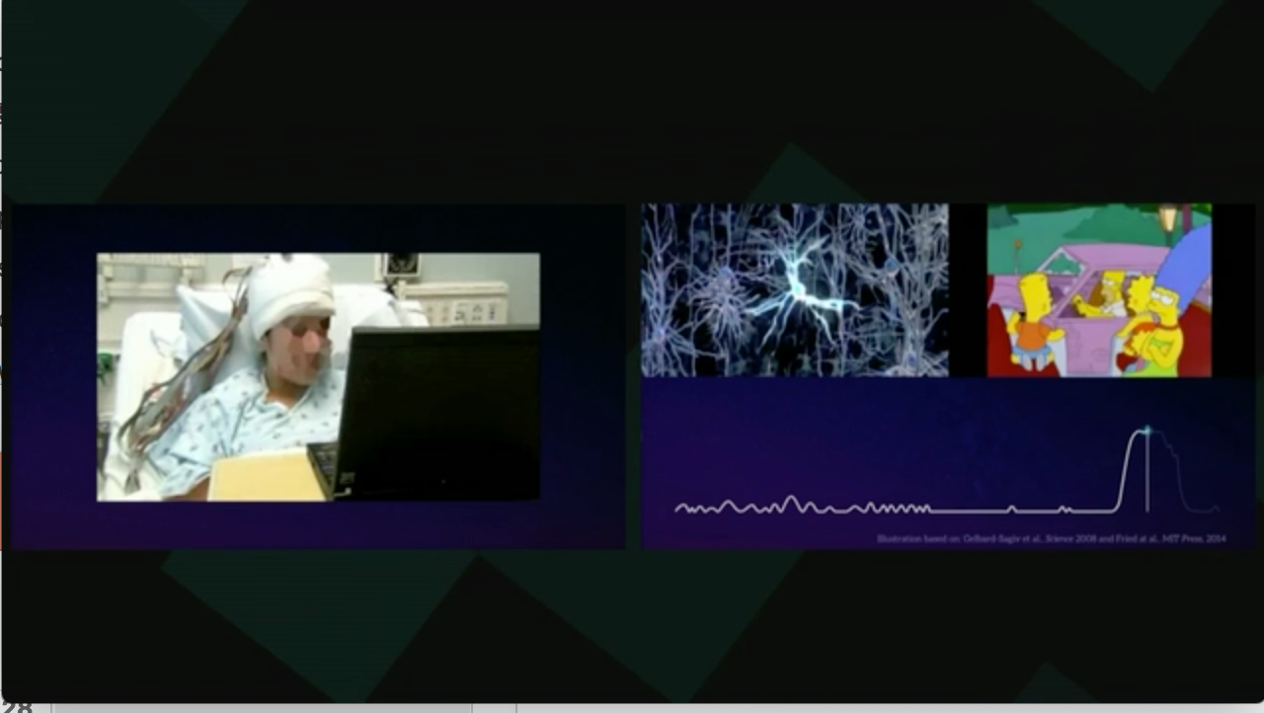
本体比喻 (Ontological Metaphor)
https://www.youtube.com/watch?v=acHxwB88dxk&t=99s

Slide 75

空间比喻 (Orientation Metaphor)
Audio-visual metaphors of the financial crisis: meaning making and the flow of experience
http://www.scielo.br/scielo.php?script=sci_arttext&pid=S1984-63982015000200311

Slide 76

系统比喻 （System Metaphor)
http://www.eoht.info/page/Analogy

Slide 77
认知的分类：个体认知能力／群体认知能力
个体认知：脑中概念的三类隐喻机制
语汇、语法、语境
群体认知：群众共同产生的概念隐喻机制
热门词典
约定成俗的行为规范
可确保成效的法规执行机制或交易渠道

Slide 78


产业与科学革命的知识体系奠基人：Thomas Kuhn
Thomas Samuel Kuhn (July 18, 1922 – June 17, 1996)
https://en.wikipedia.org/wiki/Thomas_Kuhn

Slide 79

分析产业变革的Kuhn Cycle
产业变革来自新科学知识或新工程科技所带来的“危机”，特别是认知过程中的各种困扰。
http://www.thwink.org/sustain/glossary/KuhnCycle.htm

Slide 80

Kuhn’s Cycle
https://www.thwink.org/sustain/glossary/KuhnCycle.htm

Slide 81

Kuhn’s Cycle
https://www.thwink.org/sustain/glossary/KuhnCycle.htm

Slide 82

Productivity loss due to Process Bottleneck
https://youtu.be/p7-U1_E_j3w

Slide 83

New Productivity came from CI/CD
https://youtu.be/p7-U1_E_j3w

Slide 84

关键词：Incommensurability （不可通约）
http://plato.stanford.edu/entries/incommensurability/
产业创新导致行为“范式”的转移
Paradigm shift (范式转移）
传统产业的范式，不再适用于新的社会环境
http://foodtank.com/news/2015/01/five-ways-cell-phones-are-changing-agriculture-in-africa

Slide 85

理解效果跟比喻的恰当性
http://structural-communication.com/Articles/Anatomy-metaphor-stclair.html

Slide 86
Universality : 新旧合冶，殊途同归
学说 | 范畴论 | 物理学 | 柏拉图《理想国》 | 《理想国》中的洞喻 | 东方文化 | 计算思维
对象 | 对象 | 基本粒子 | 影像、理念 | 影子、木偶 | 感官（六触、十二处、十八界）、本性 | 输入、输出的比特和量子比特数据
关系 | 箭头 | 四种相互作用 | 投射，显现 | 火光映射 | 缘起 | 通用的逻辑门或Hamiltonian时间演化、拓扑结构变换
结构 | 映射结构 | 大统一理论(QM/SR/GR/GFT) | 以辩证法为主体的城邦护卫者的教育学 | 从洞内到地面的显现过程 | 中观（性空），唯识（缘起现象），心学（惟精惟一，允执厥中） | 逻辑门线路模式、绝热演化模式、拓扑变换模式
主客观之间 | 打通 | 接近打通：量子测量 | 留有空间：“假设” |  | 打通 | 人脑是一台量子计算机？

Slide 87
本体论与命名空间管理

Slide 88

Symmetries and Arrows
Image source: https://youtu.be/pt0aorJvKVg?t=53

Slide 89
隐喻的分类：本体／空间／系统 Metaphors are Symmetries in Meaning
本体隐喻：脑中的概念与实体世界的联系
已熟悉的词汇 （如桌椅、门窗、飞禽走兽。。。）
空间隐喻：各物品或概念单元的时空定位关系
物件中的上下左右、事件发生的前后（偏序关系）
社会地位、亲属联系的高低大小关系
系统隐喻：整套物品（事件）的结构类似性
机器人对应与木流牛马
计算机的作业系统对应与国家的宪章

Slide 90


管理本体隐喻：管理MediaWiki词汇

Slide 91
Mathematical Models: A Sketch for the Philosophy of Math (1981)
Saunders Mac Lane从数学文献中所总结出的各种动词片语
Counting | Arithmetic, Number Theory
Measuring （度量） | Real Numbers, Calculus, Analysis
Shaping （分辨形体） | Geometry, Topology
Forming （成形） | Symmetry, Group Theory
Estimating （估测） | Probability, Measure Theory
Moving （移动） | Mechanics, Calculus, Dynamics
Calculating （计算） | Algebra, Numerical Analysis
Proving （证明） | Logic
Puzzling （解谜、加密） | Combinatorics, Number Theory
Grouping （聚类） | Set Theory, Combinatorics
http://links.jstor.org/sici?sici=0002-9890%28198108%2F09%2988%3A7%3C462%3AMMASFT%3E2.0.CO%3B2-D
Notes:
Category theory has become an important role in contemporary mathematics and theoretical computer science.

Slide 92
知识图谱：Ontological Engineering
Ontology engineering … studies the methods and
methodologies for building ontologies:
… formal representations of a set of concepts
… Core ideas and objectives of ontology engineering
are also central in conceptual modeling.
https://en.wikipedia.org/wiki/Ontology_engineering

Slide 93


可计算图：Computable Diagrams

Slide 94


可计算图形语意：Computable Semantics

Slide 95

















Arrows are “mappings” between objects, categories and functors
Category theory : Arrow chasing
1. Function
$$A \underset{→}{ f } B$$
$$A$$
Object / Set $A$
Category $S$
A function $compares two objects$
2. Functor
B
$$S$$
$$\underset{→}{ F }$$
$$T$$
E
A Functor $compares two$categories
A
C
D
F
$$S \underset{→}{ F } T$$
Functor $F$
$$F$$
3. Natural Transformation
A Natural Transformation compares two Fuctors
$$S$$
$$η$$
$$T$$
$$F \underset{→}{ η } G$$
Natural Transformation $η$
Source : Schalk and Simmons, 2005
$$G$$

Slide 96


Slide 97


Category Theory was invented to compare “Analogies”
Let’s see the example :
Functor
Category
Natural Transformation
Source : Milewski, 2015

Slide 98
词汇的比较 （Saunders Mac Lane vs. Modelica）
Counting | Arithmetic, Number Theory
Measuring （度量） | Real Numbers, Calculus, Analysis
Shaping （分辨形体） | Geometry, Topology
Forming （成形） | Symmetry, Group Theory
Estimating （估测） | Probability, Measure Theory
Moving （移动） | Mechanics, Calculus, Dynamics
Calculating （计算） | Algebra, Numerical Analysis
Proving （证明） | Logic
Puzzling （解谜、加密） | Combinatorics, Number Theory
Grouping （聚类） | Set Theory, Combinatorics

Slide 99

Complex Diagram Can be Simplified by Category Theory
CATEGORY THEORY
OPN Program
computes all the possible
trayectories to
the moon and
back
Author:
Benjamin Koo

Slide 100
How Category Theory Simplifies Product Development
For a start-up, there are two possible outcomes which define two maneuvers, one reversible:
Succeed after a process, advance
Failed after a process, repeat, roll back [opposite from advance]
Repeat
Identify customer needs and problems
Advance
Advance (R&D)
Repeat
Roll Back
Roll Back
Repeat
Target specification and proof of concept
Roll Back
Development techniques / framework
Advance

Slide 101
How Category Theory Simplifies System Development
Can be simplified as :
A
B
Domain
Codomain
Data Gathering
Data Specifications
Identity Functor
Identity Functor
Eevery connection is reversible
Codomain
Domain
Infinite possibilities!!!
Find the viable paths to succeed!
Notes:
Identity functor

Slide 102

Guide book
https://dewabharata.gitbooks.io/category-theory-for-dummies-by-dummies/content/

Slide 103


Slide 104


Slide 105




复杂网络专用的编程语言 NetLogo
Agent-based Modeling

Slide 106


数学化的概念 Conceptual Mathematics
Authors:
William Lawvere
Stephen Schanuel

Slide 107

范畴论：复杂网络的数学 （John Baez）
尤亦庄： …引力、量子纠缠和人工智能正是在这里走到了一起。它们之间涌现出一个共同的主题，那就是复杂网络。-
本页的图文来自尤亦庄的 “引力、量子与人工智能的深度对话”
：http://mp.weixin.qq.com/s/UBG8-3FKkyE6DrUJ2CXIAA

Slide 108
Carlo Rovelli的 Ontological Map of Space-Time
Covariant Loop Quantum Gravity: An Elementary Introduction of Quantum Gravity Theory and Spinfoam Theory
by Rovelli and Vidotto

Slide 109
泊松括号(Possion Bracket)
泊松括号在数学及经典力学中是哈密顿力学重要的运算，在哈密顿表述的动力系统中时间推移的定义起着中心角色。
2. 泊松括号在量子力学中有很重要的作用。它与量子力学的联系最早是由狄拉克提出的，他发现量子力学中力学量的对易关系与经典力学中的泊松括号非常相像，在这个基础上，狄拉克创立了量子力学的符号法，根据这种类比，我们只要在下面所讨论的力学量的运动方程左边乘上一个因子ih，就得到了量子力学的海森堡方程；只要在下面基本泊松括号等号的右边乘上一个相同的因子ih，就得到了量子泊松括号（量子力学中将它称为对易子）。
来源：https://baike.baidu.com/item/泊松括号/979973?fr=aladdin
Leonard Susskind's Theoretical Minimum: Classical Mechanics
https://youtu.be/HVUj9ep2POQ

Slide 110


泊松括号的定义
来源：https://baike.baidu.com/item/泊松括号/979973?fr=aladdin

Slide 111


泊松括号的性质和在量子力学中的应用
来源：https://baike.baidu.com/item/泊松括号/979973?fr=aladdin

Slide 112
《理想国》的理念世界和影像世界
1. 影像：感官所能感受到的现象
2. 意见：关于现象的认知
3. 理智：把意见当成影像，基于范畴、逻辑假设，推导出结论；假设的真实程度影响结果的真实度。由以辩证法为主轴的训练提升到理性层面。
4. 理性：超越假设，接近实相

Slide 113
《理想国》的理念世界和影像世界
1. 影像：感官所能感受到的现象
2. 意见：关于现象的认知
3. 理智：把意见当成影像，基于范畴、逻辑假设，推导出结论；假设的真实程度影响结果的真实度。由以辩证法为主轴的训练提升到理性层面。
4. 理性：超越假设，接近实相

Slide 114
参考文献
Computational Thinking and System Design NAND2GO, Supervised by Dr. Ben Koo, Spring 2019.
Elements of Computing Systems, Nisan & Schocken, MIT Press, www.nand2tetris.org, Chapter3: Sequential Logic.
理想国，[古希腊] 柏拉图著，郭斌和、张竹明译，商务印书馆，1986年版。
4. 清华大学校歌，汪鸾翔先生作词，张慧珍女士作曲，评审于1923年前后。
.

Slide 115












产业分析报告模板
全球创新／制造战略

Slide 116


写简短的个人传记

Slide 117

可视化的内容大纲

Slide 118

调研历史背景

Slide 119

产品功能对比

Slide 120

市场分析

Slide 121

Sketch: 绘制故事板的工具

Slide 122

Sketch: 绘制故事板的工具

Slide 123

InDesign: 排版工具

Slide 124

Phabricator 出版工作流的任务分派

Slide 125

Phabricator 出版工作流的个人任务

Slide 126

Sensor Placement and Data Collection

Slide 127

Wolfram Physics and Category Theory

Slide 128

Embrace Complexity, Scale Agility
Notes:
In order to successful scale any method or practice, it has to have some basis in theory. This presentation will use insights from complex adaptive systems theory and the cognitive sciences to lay a foundation for that theory. Seeing software development as a problem of knowledge management, the theory will elaborate a understanding of applications as the emergent property of a co-evolutionary interactions between technology capability and unarticulated user requirements. Having established a basic theory a range of methods and tools will be elaborated. These include: - Narrative based approaches to requirements capture (not to be confused with Story telling or story boarding) which gather thousands of fragmented self-signified anecdotes relating to real and imagined needs within a user community and allow interpretation and integration into project planning. - Approaches to project planning and implementation that focus on the creation of self-organising teams of specialists and users to create novel approaches, supported by evidence to previously intractable problems. This is particularly relevant to the 5-10% of any major project which creates 95-90% of the grief. - The integration of tools such as blogs, wiki's etc into the development environment. Too often corporate environments over-constrain those tools into over rigid structures which destroy their utility. Conference: http://2015.agileindia.org

Slide 129




The Pursuit of a Unified Representation
Prof. Frank Wilczek of MIT, the Nobel Prize in Physics in 2004 "for the discovery of asymptotic freedom in the theory of the strong interaction."

Slide 130

Computable Logic and Types of “Birds”

Slide 131


The Names of Birds (Functions)

Slide 132

Biology and Physiology

Slide 133


Industrial and World Dynamics
The World is made of three kinds of things:
Stock, Flow, and State variables parameterized in time

Slide 134



The Larger Contexts

Slide 135

Why do people study the following subjects?
Macro Economics, Societal Cybernetics
Identify human behavioral patterns at scale
Environmental Science, Oceanography
Where we live and how we survive on the planet
Cosmology
The origin of space, time, energy and all the fundamental things relevant in our universe.

Slide 136



Cybernetics: Communication and Control

Slide 137





Cybernetics and the Social Behavioral Science

Slide 138








Alan Turing’s Papers
http://sitn.hms.harvard.edu/flash/2012/morphogenesis/
https://www.csee.umbc.edu/courses/471/papers/turing.pdf
https://www.mathtube.org/lecture/video/alan-turing-and-decision-problem

Slide 139
The Governing Rules of Story Telling
Generate deep and sustained reflections
The outcomes of Story Telling is determined by the Quality of Composition
Story thread convergence by adopting a unifying foundation (arrow)
Everything is done through the composition of arrows
Category Theory provides a computational framework to verify and generate compositions.
Richness of Expressiveness through NsM
Managing possible variations in a VERY LARGE POSSIBILITY SPACE using NsM (compression techniques)

Slide 140



An example of Automaton
The state bounds of
busy beaver
(according to Wikipedia)
Image Source: https://en.wikipedia.org/wiki/Turing_machine

Slide 141



Non-Equilibrium Thermodynamics

Slide 142
What, How and Why
What/Association marks data content (Hyperlink in URL)
How/Intervention demonstrates active intent (human free will)
Why/Counterfactuals checks on associations by breaking symmetry
Branching on the assumptions/contextual groundings
It is the simplicity of data types (associations) that enables scale
All data types share the same basic type (association/arrow/label/named object)

Slide 143


The Surprising Simplicity of Everything

Slide 144

What is Universality?
What is in common between Bus Arrival, Riemann Zeta Function, Chicken Retina, and Quantized Energy?

Slide 145



The Rosetta Stone by John Baez
Image source: wikipedia

Slide 146
The Rosetta Stone of Scientific Language
Biology | Math | Physics | Cybernetics/System Sciences
Homeostasis/DNA | Iterative/Recursive Functions | Multi-Scale Interactions | Feedback Loops
Cellular Construction/Boundary Setting | Difference/Differentiation | Observations | Data Collection
Lifespan Expansion | Integration | Spacetime Accumulation | Statistical Interpretation
Entropy Negation | Numbers/Generative Name Spaces/Algebras | “Unified” Theory | From Theory to Applications and Back

Slide 147


Differentiate by Breaking Symmetries
“THE TEN CHARACTERISTICS OF DIFFERENCE THINKERS
They practice empathy because they care enough to make an impact.
They have a clear sense of the change they want to make in the world.
They are impatient about tactics and endlessly patient about implementing their strategy.
They ask the right questions, and that means that they talk more than twice as much as they listen, because talking takes guts. Mostly, they ignore those who offer empty criticism.
They watch what people do and don’t just believe what people tell them.
They innovate and create at the edges, ignoring the market of everyone.
They make products for their customers, instead of trying to find customers for their products.
They understand that they need to give people a story to tell—a ‘you’ve gotta see this’ moment.
They work hard to change how people feel, by creating intangible value that gives them an emotional point of difference.
They understand that trust is their second-most valuable asset. The first is the willingness to be wrong for the right reason.”
Excerpt From: Bernadette Jiwa. “Difference: The one-page method for reimagining your business and reinventing your marketing.”
Notes:
Whats also refers to Data.

Slide 148


Does this Remind you of …
Notes:
Whats also refers to Data.

Slide 149
Historical Threads of Story Telling
Key Personalities (Lars Andersen)
Think Robin Hood
Technology History (Bows and Arrows)
The archer’s Paradox (science and wizardry)
Institutional/Regulatory History
Stories must evolve with societal and institutional rules
Notes:
Whats also refers to Data.

Slide 150

Representing Numbers using Arrows
Image source: https://youtu.be/KQv0lEaDGco?t=662

Slide 151
The Cognitive Considerations of Story Telling
Pick a Context that is most relevant to the ”thesis” or “moral” or the story
Contextualization, assess a proper boundary of space-time significantly reduce entropy(information)
Technologies can accelerate information processing
If the information channel capacity is overloaded, tech can help
Institutional/Regulatory Foundation creates a stable filter of information
The constitution and historical reputation of an organization could also be used as a agency for information processing

Slide 152
Construct Story Telling using Metaphorical Connections
 | Story Telling | Metaphors | Categorical Arrows
Dynamics | Story Plot | Types of Outlines | Natural Transformation
Compositional Laws | Morals of the Story | Existing Stories | Functor/Structure Preservation
Building Blocks (BB) | Spacetime Context and the Characters | Names of the BB | Functions/Morphisms/Objects

Slide 153
Summary
Arrow/Symmetry-breaking Symbols provide a unified notation for being cognizant of something
All types of things can be represented using Arrow
The power of Category Theory/Arrow Chasing is in its simplicity
The conceptual barriers of using Category Theory/Arrow Chasing is also due to its simplicity
Maybe improved NsM for Category Theory/Arrow Types could help?
Terms to remember: Limits/Colimits, Monad, Yoneda Lemma, Kleisli Category, Horizontal and Vertical Compositions

Slide 154
Students Actions before Monday October 12
Catching up on toyhouse.wiki:81 with all content
Prepare for a 10 minute presesentation about your project
What is the topic? The name of your project?
Please contact each other to double-check your thesis
Your strategy to collect references
What is your strategy to manage the “namespace”
Can you succinctly prescribe the spatial/temporal context of the project?

